Slide 1
INTRODUCTION TO
ALGORITHMS
FOURTH EDITION

Slide 2
LECTURE NOTES FOR CHAPTER 30
Polynomials and the FFT

Slide 3
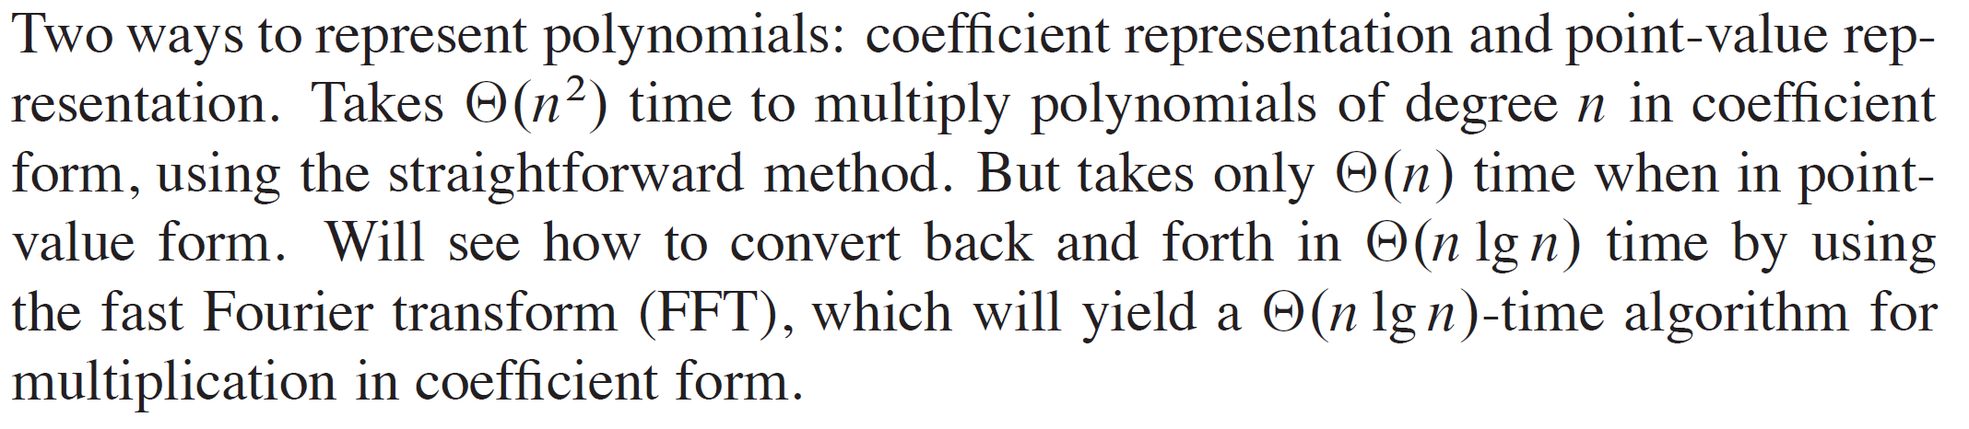
CHAPTER 30 OVERVIEW

Slide 4
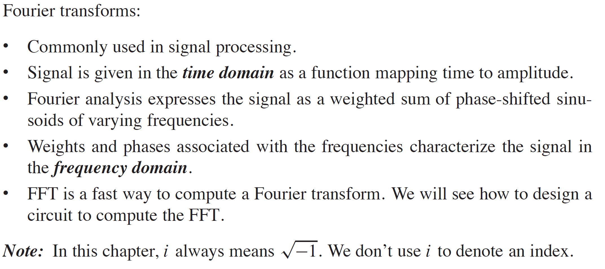
CHAPTER 30 OVERVIEW (continued)

Slide 5
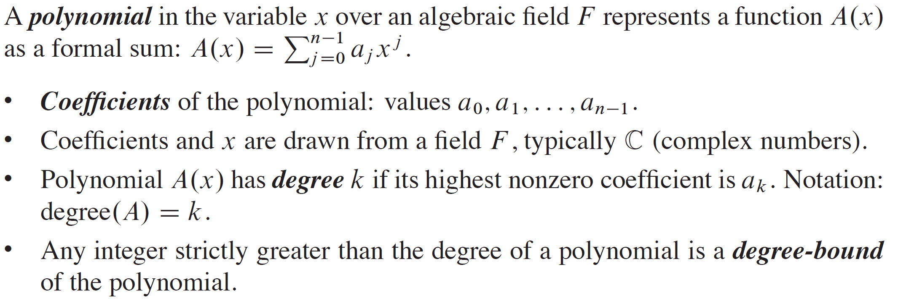
POLYNOMIALS

Slide 6
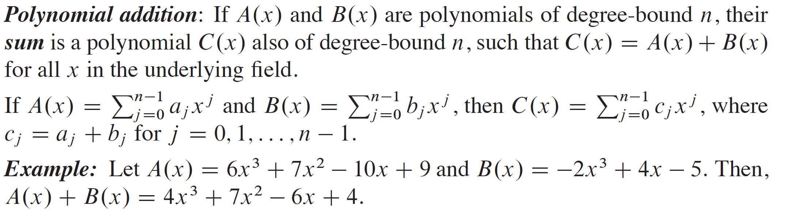
POLYNOMIALS (continued)

Slide 7
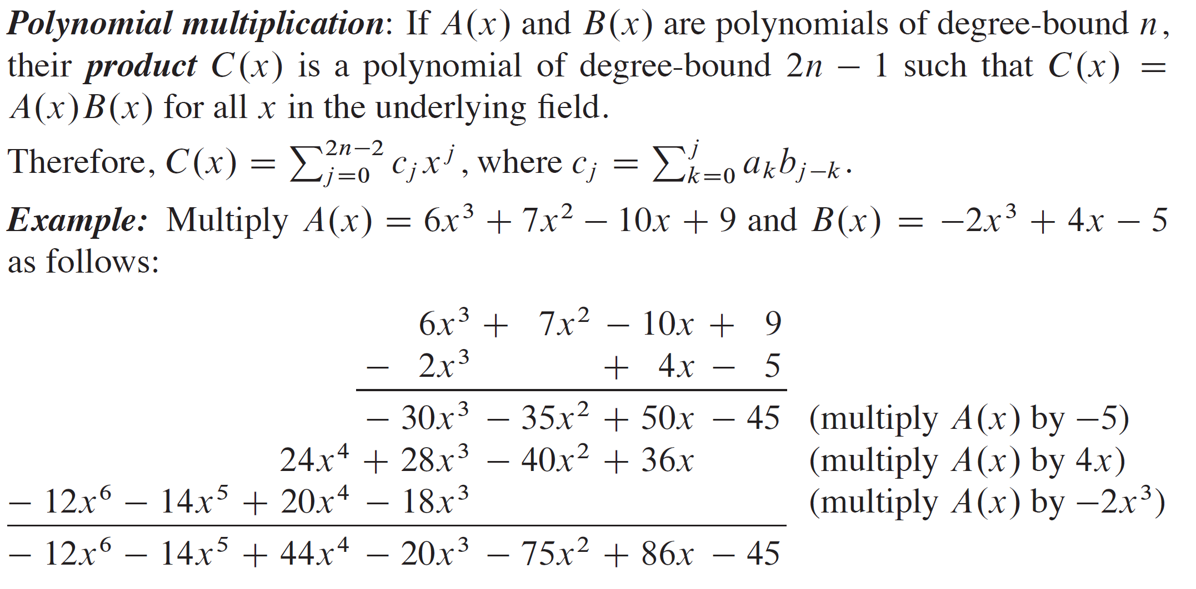
POLYNOMIALS (continued)

Slide 8
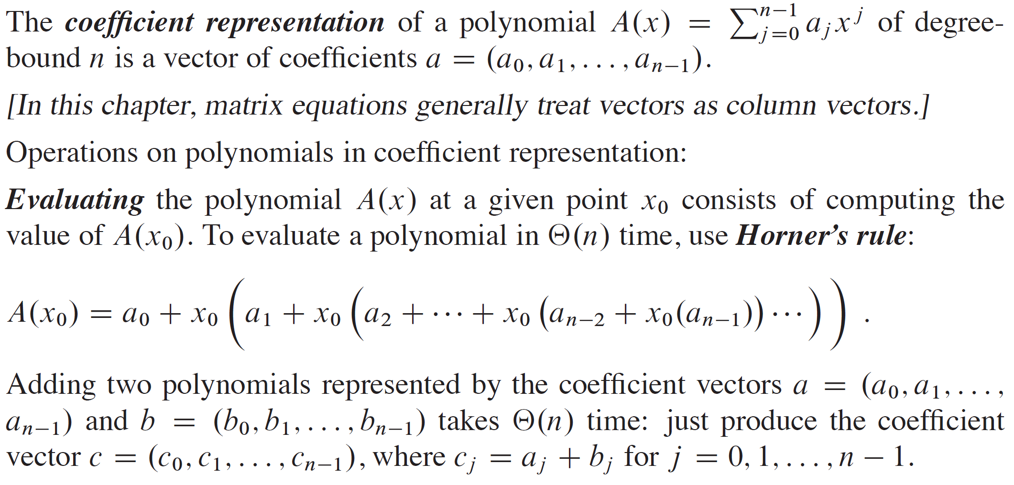
COEFFICIENT REPRESENTATION

Slide 9
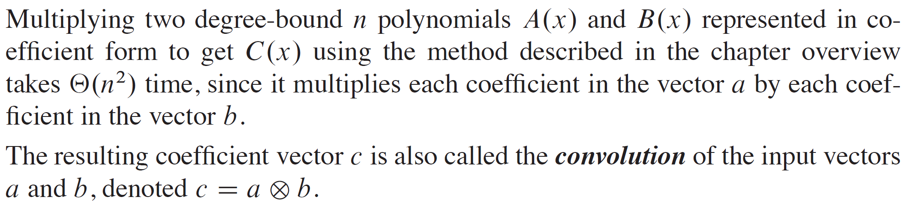
COEFFICIENT REPRESENTATION (continued)

Slide 10
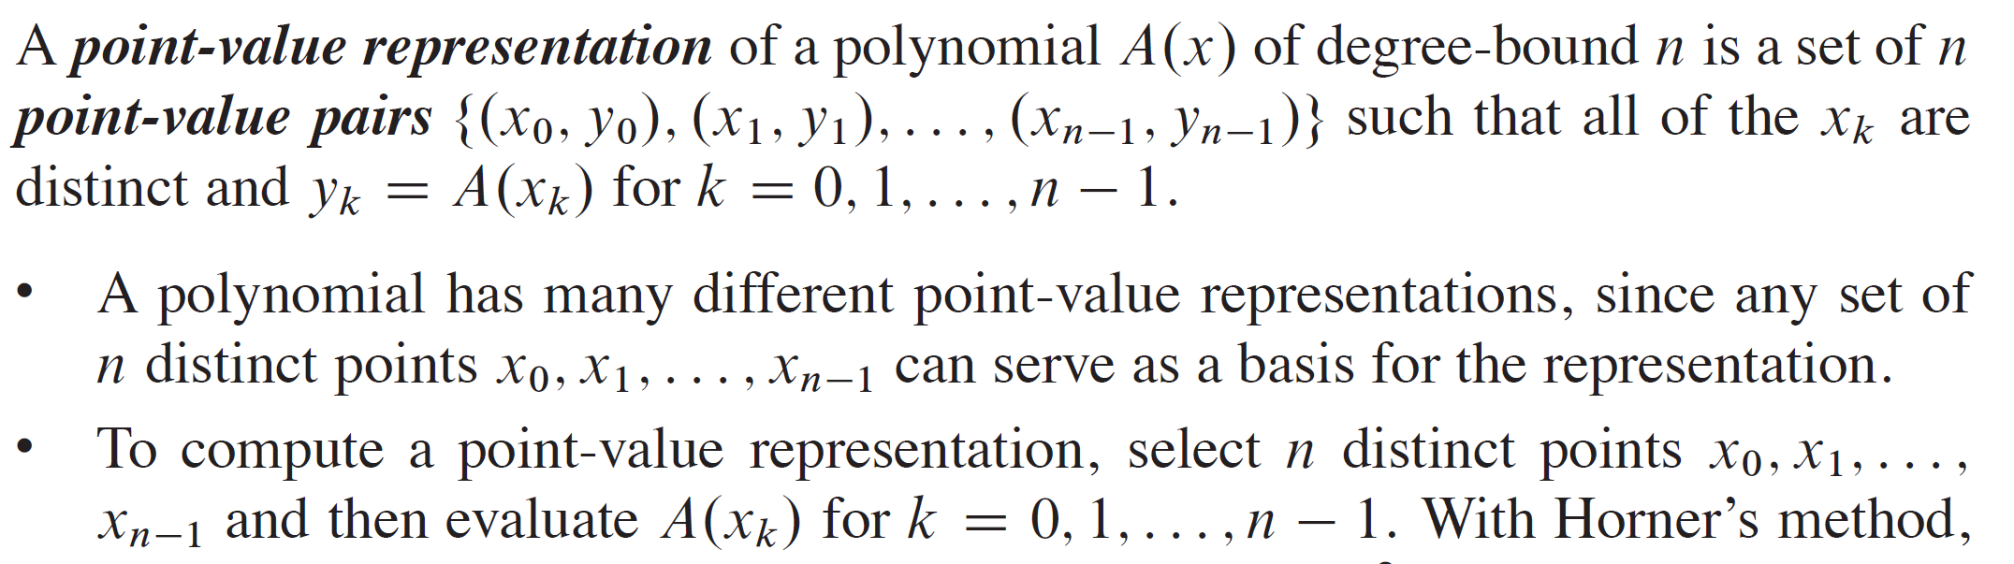
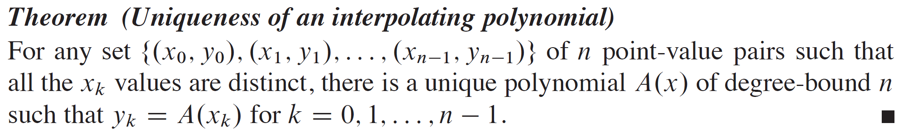
POINT-VALUE REPRESENTATION

Slide 11
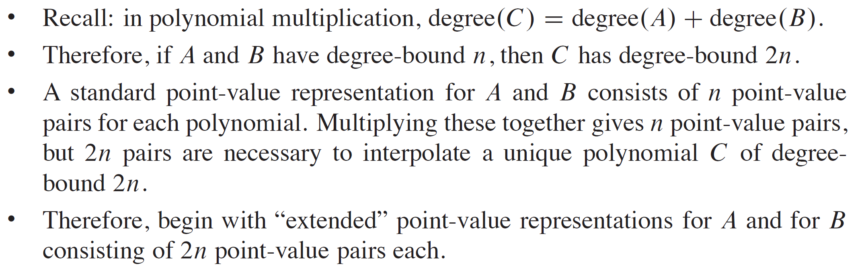
OPERATIONS ON POINT-VALUE REPRESENTATIONS

Slide 12
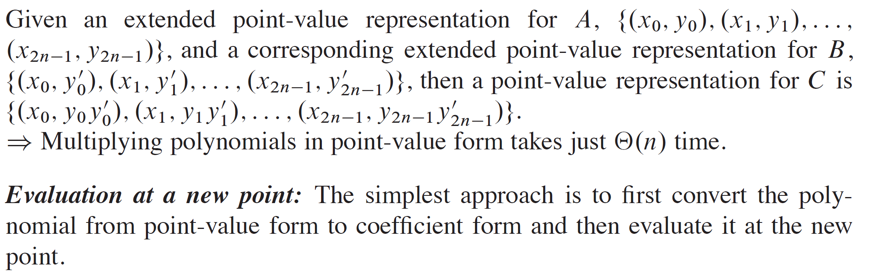
OPERATIONS ON POINT-VALUE REPRESENTATIONS (continued)

Slide 13
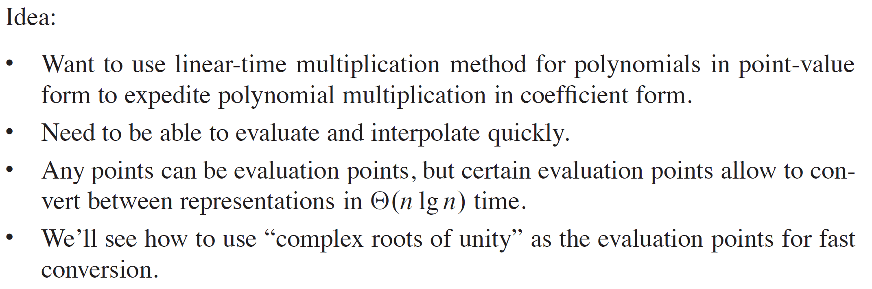
FAST MULTIPLICATION OF POLYNOMIALS IN COEFFICIENT FORM

Slide 14
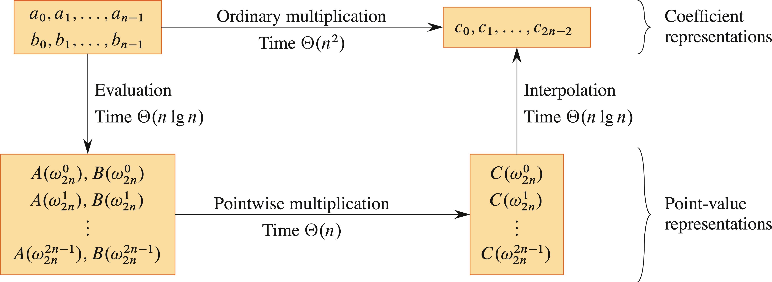
ILLUSTRATION

Slide 15
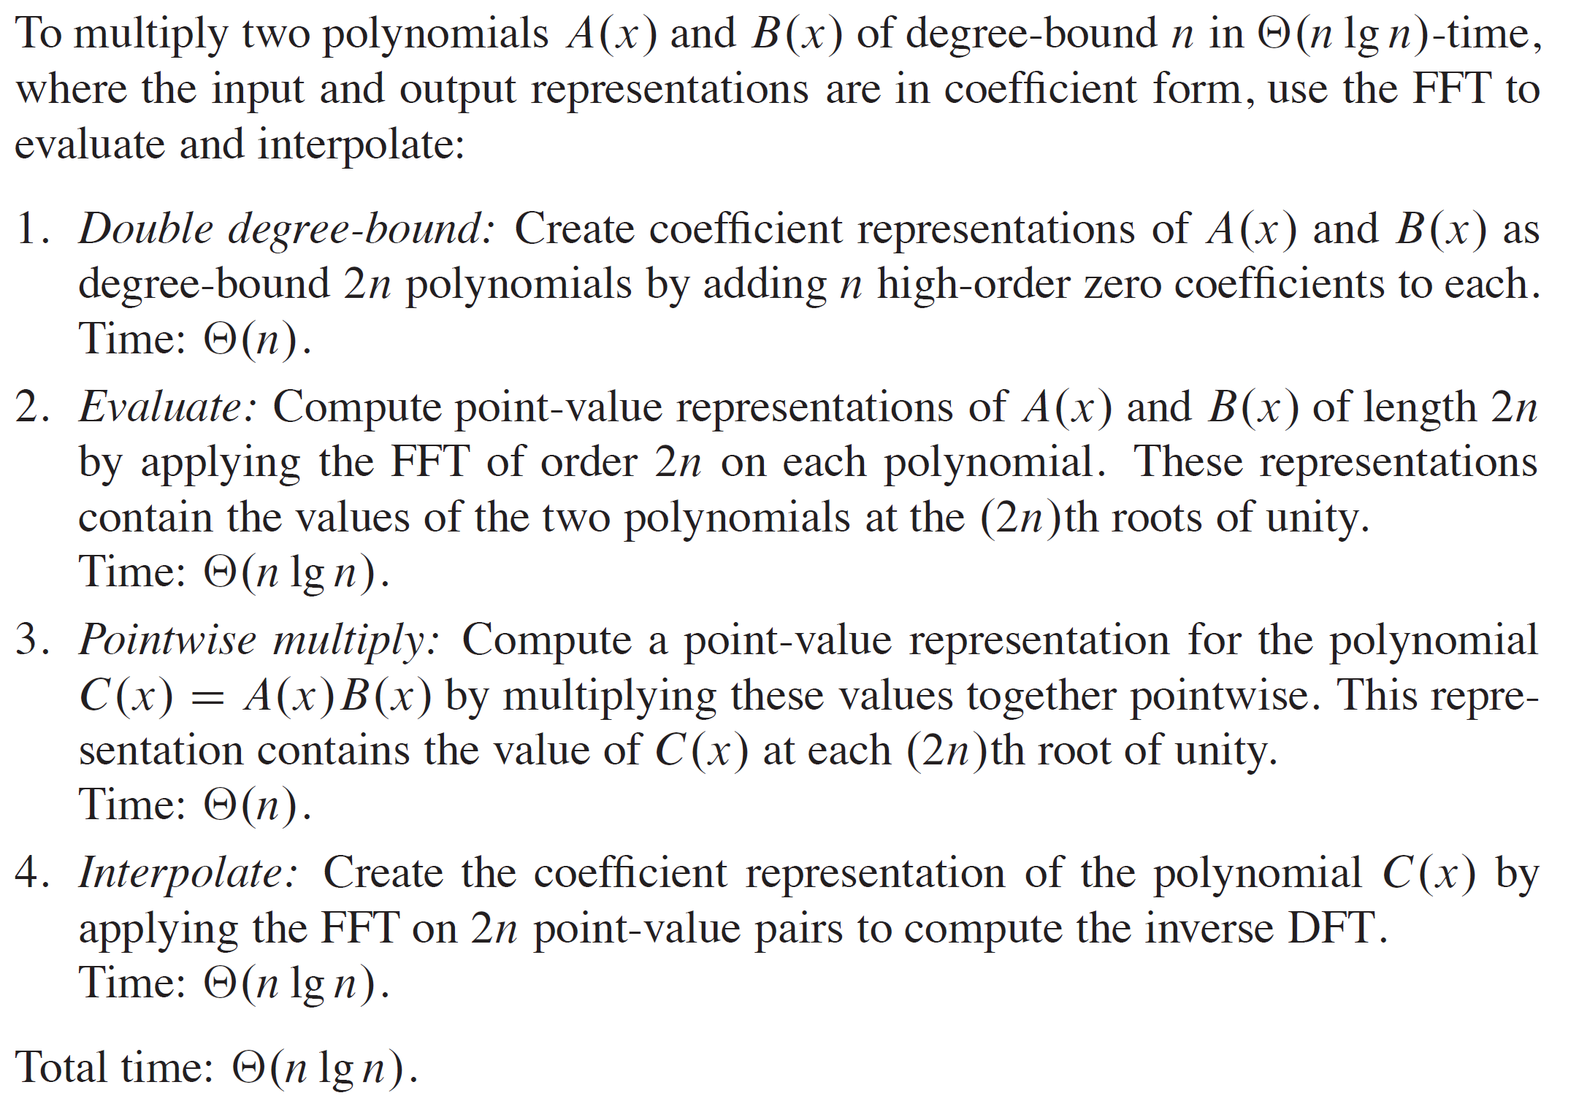
ILLUSTRATION (continued)

Slide 16
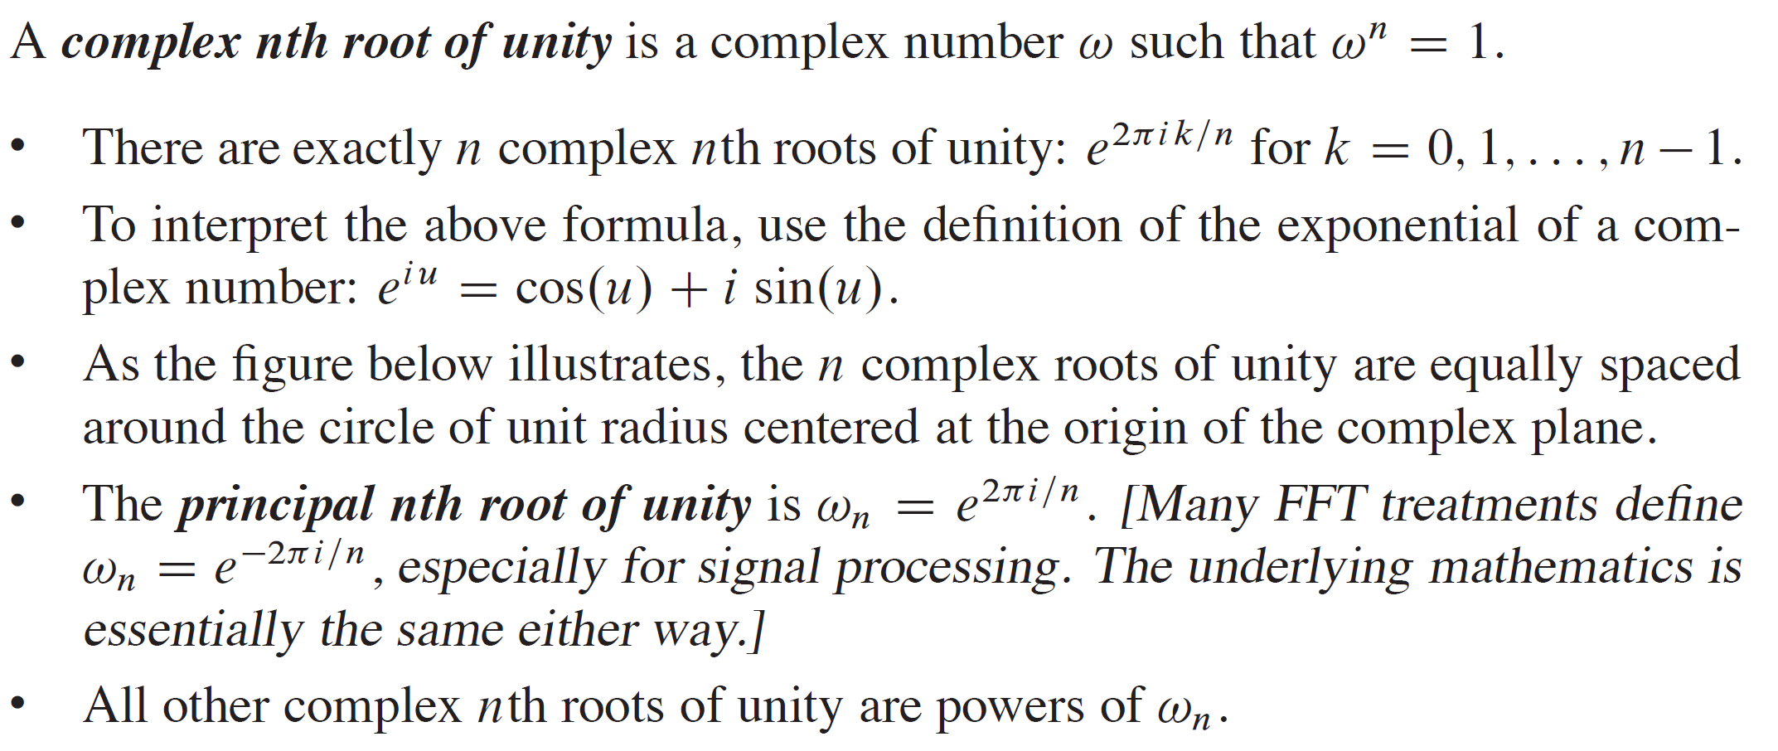
COMPLEX ROOTS OF UNITY

Slide 17
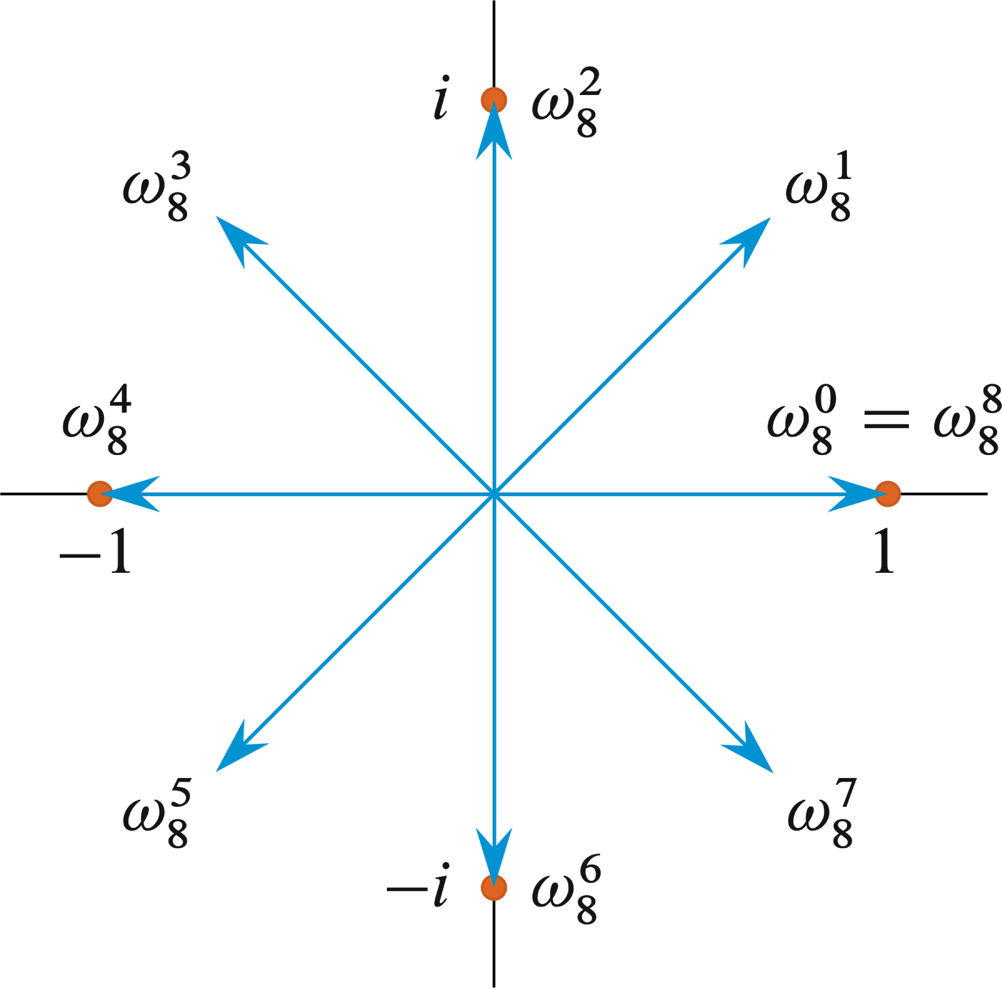
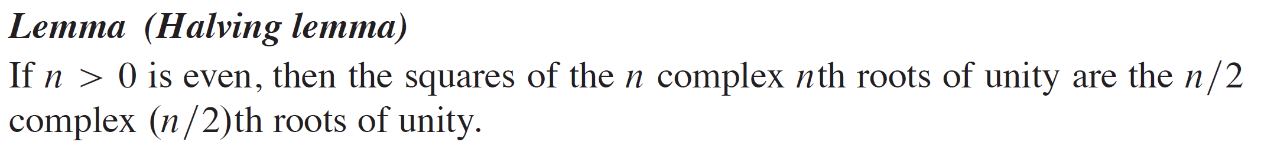
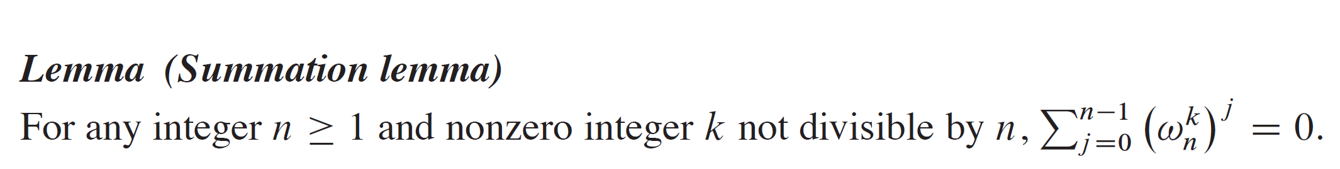
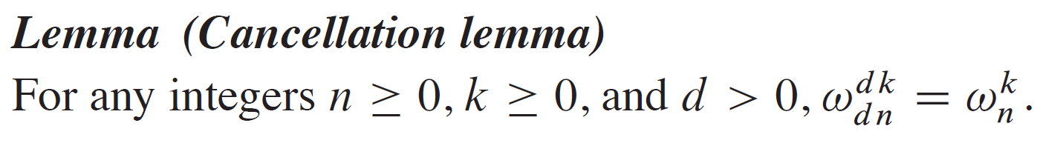
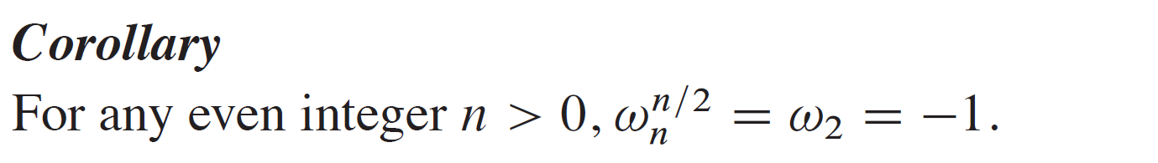
COMPLEX ROOTS OF UNITY (continued)

Slide 18
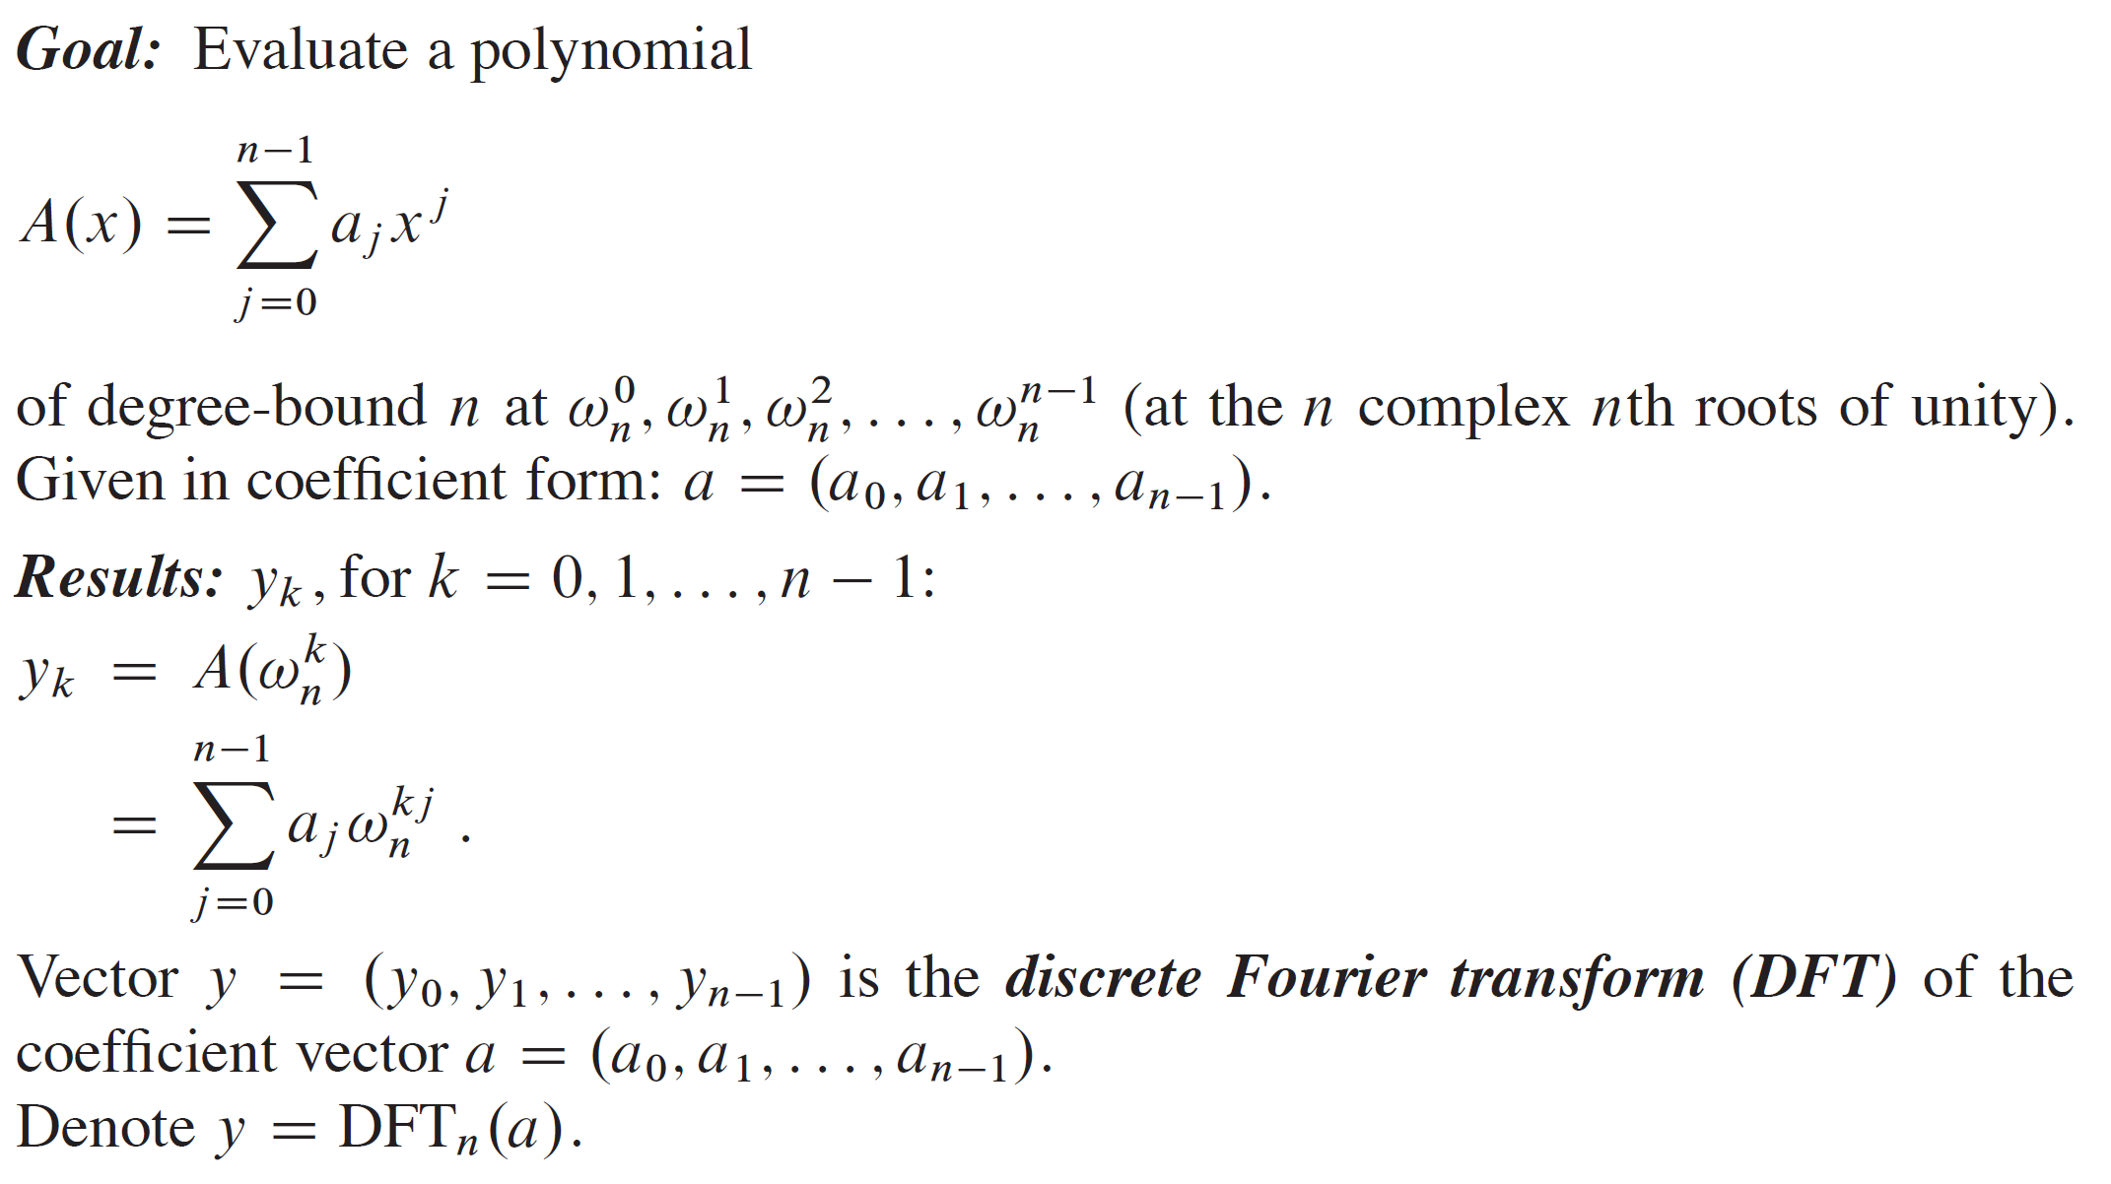
THE DFT

Slide 19
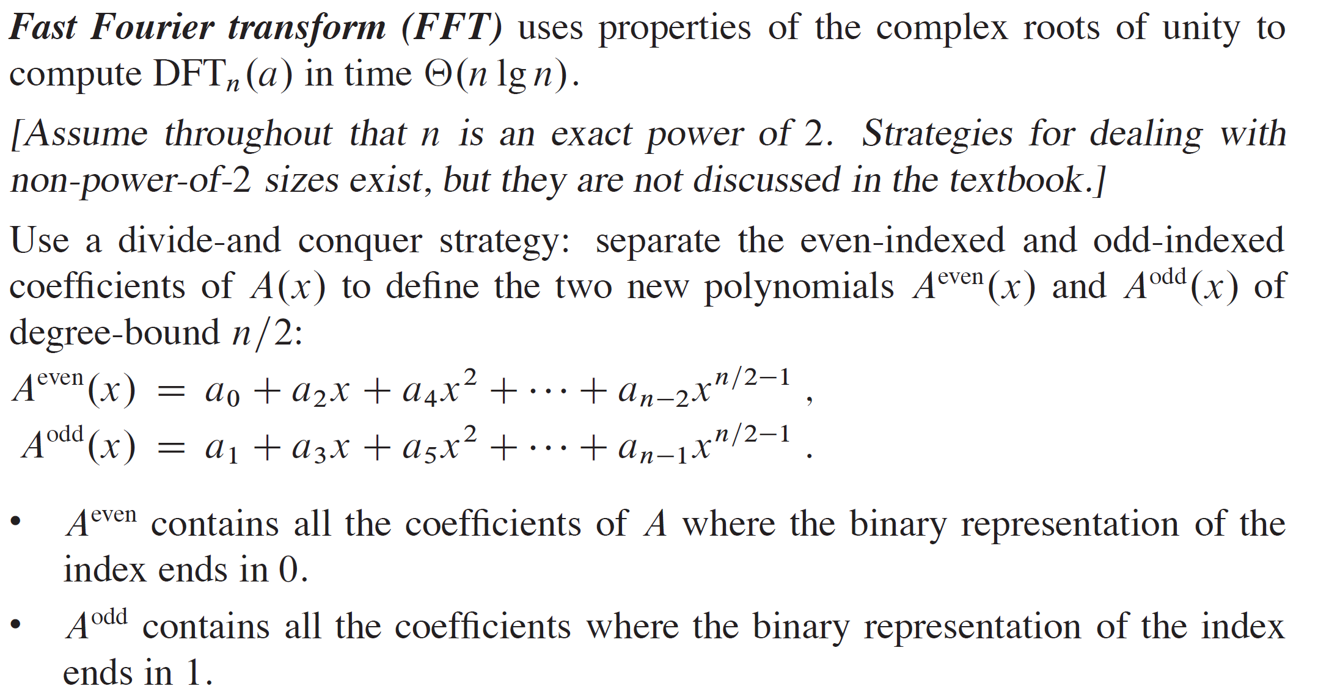
THE FFT

Slide 20
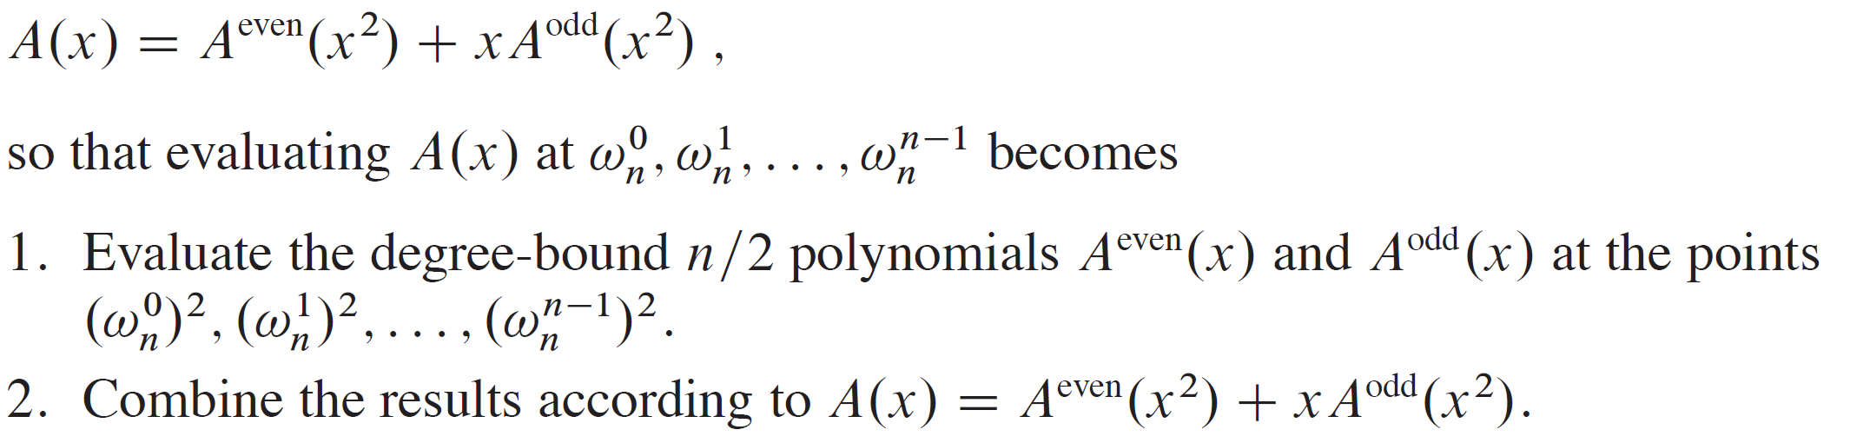
THE FFT (continued)

Slide 21
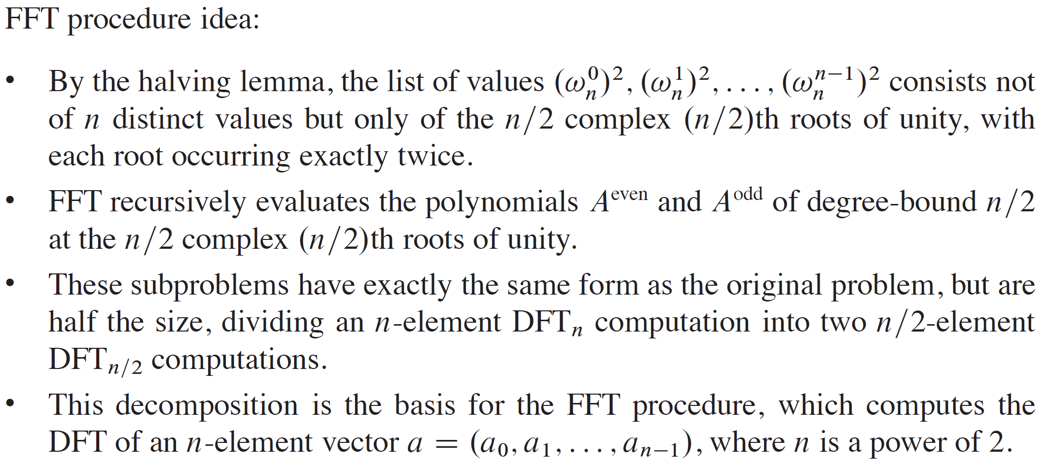
THE FFT (continued)

Slide 22
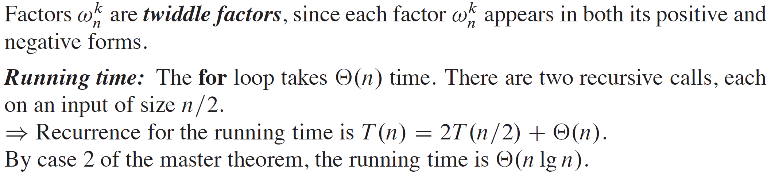
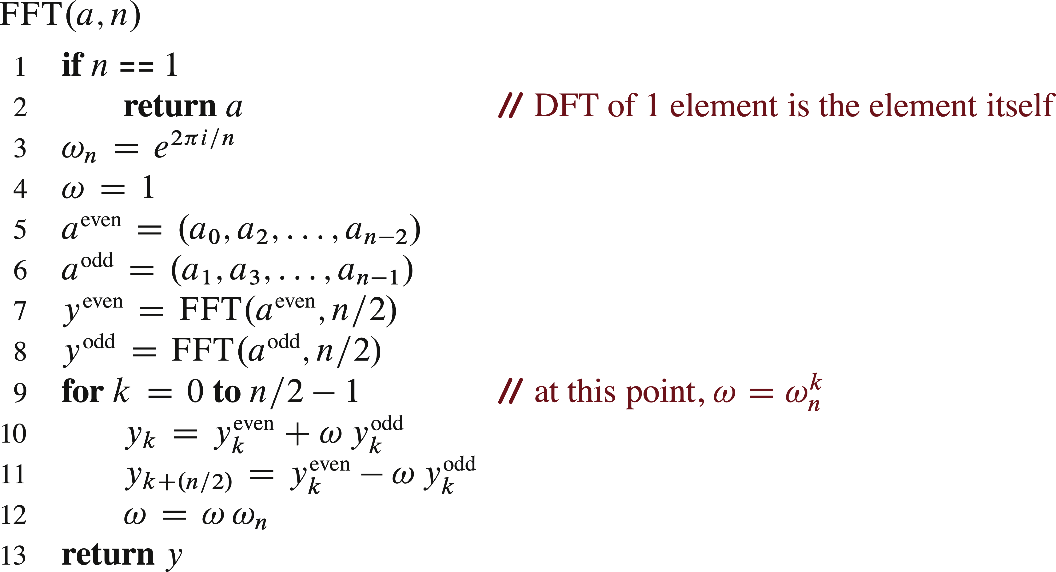
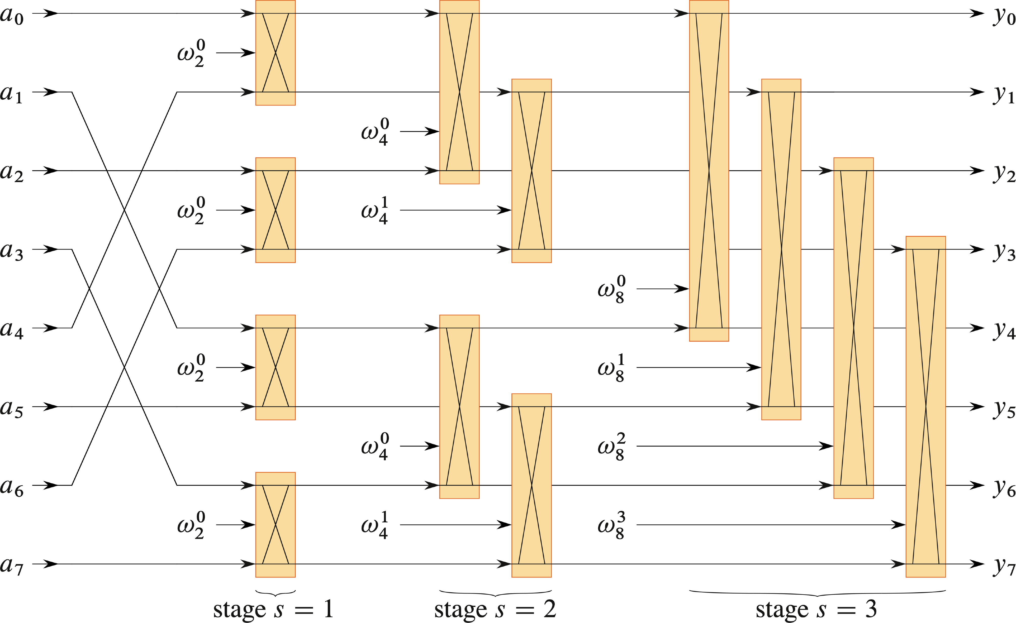
PSEUDOCODE
E

Slide 23
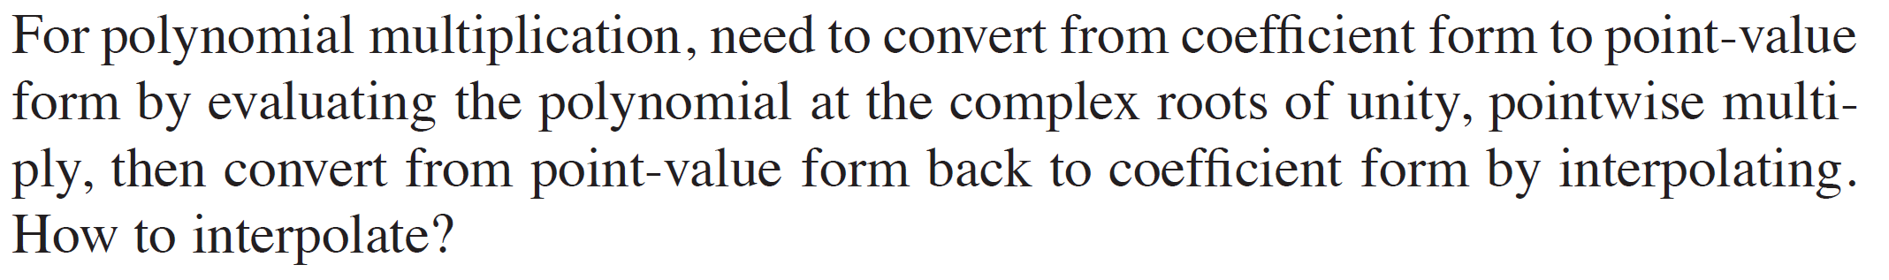
INTERPOLATION AT THE COMPLEX ROOTS OF UNITY

Slide 24
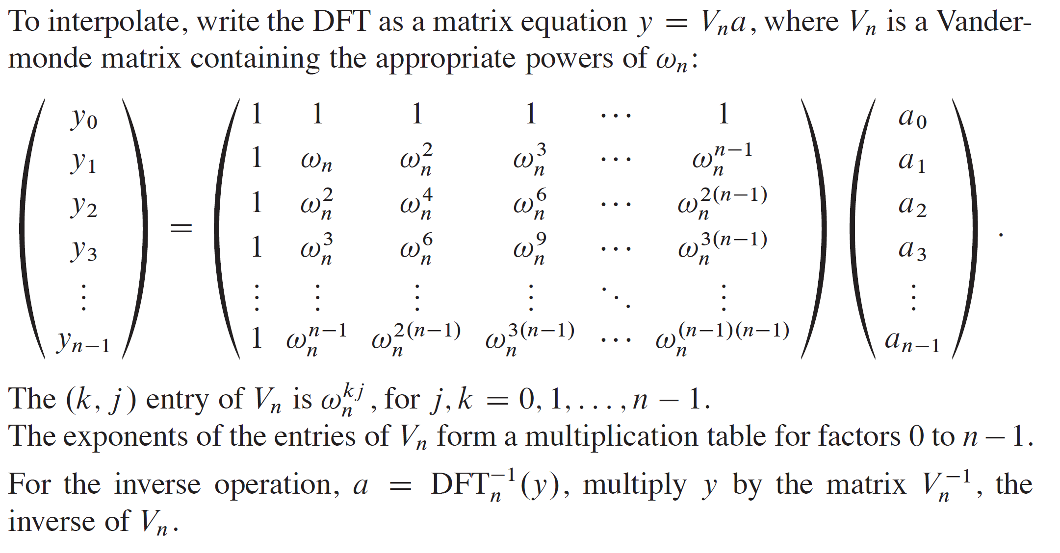
INTERPOLATION AT THE COMPLEX ROOTS OF UNITY (continued)

Slide 25
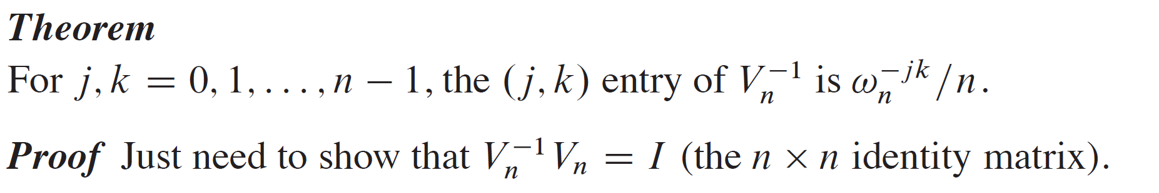
INTERPOLATION AT THE COMPLEX ROOTS OF UNITY (continued)

Slide 26
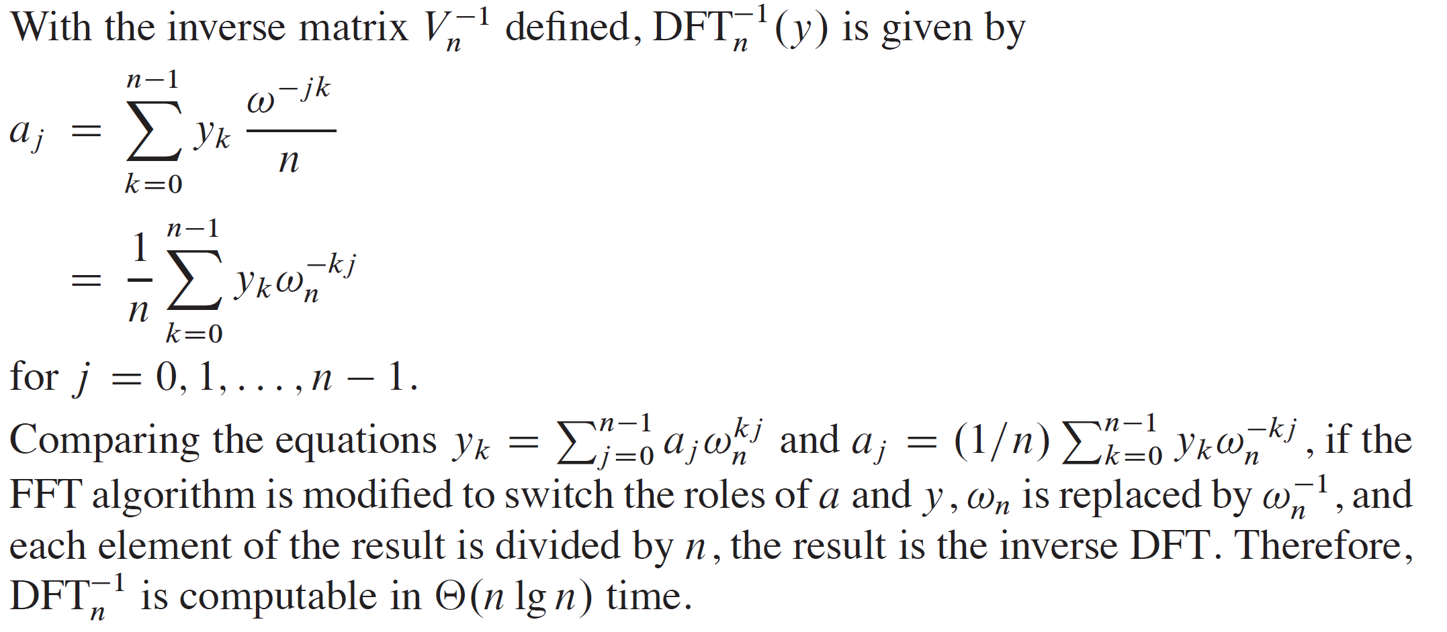
INTERPOLATION AT THE COMPLEX ROOTS OF UNITY (continued)

Slide 27
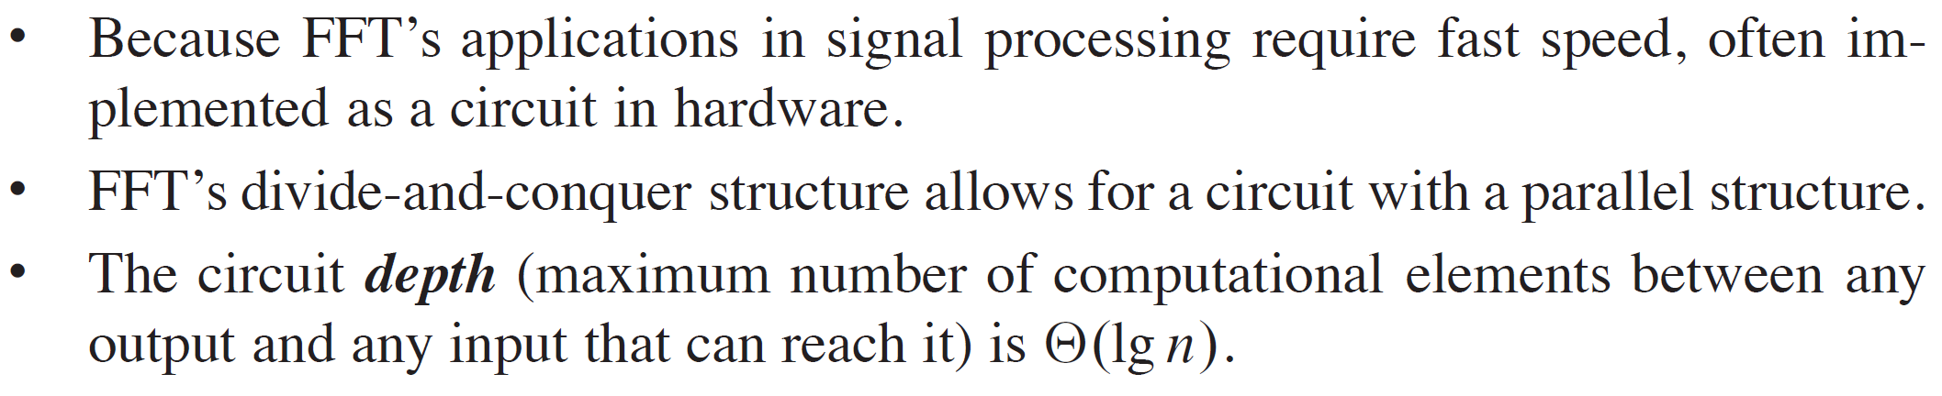
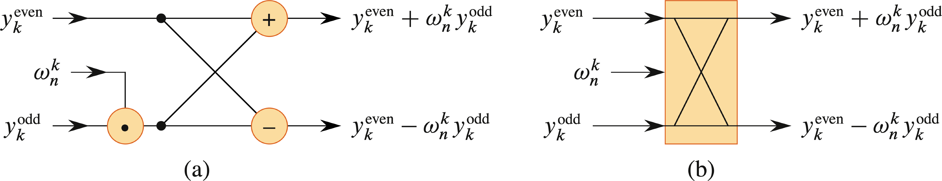
FFT CIRCUITS
Simplified View

Slide 28
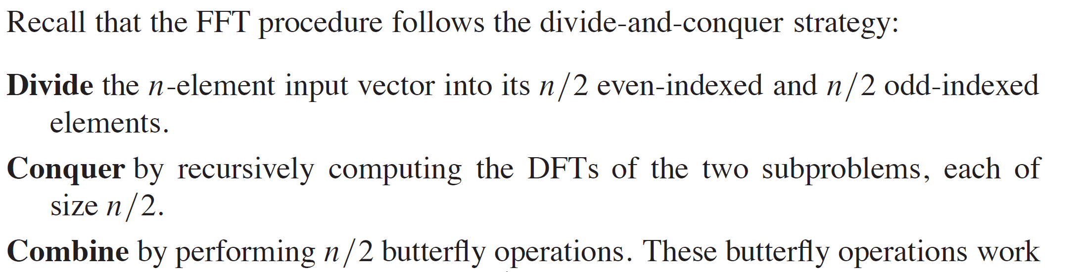
RECURSIVE CIRCUIT STRUCTURE

Slide 29
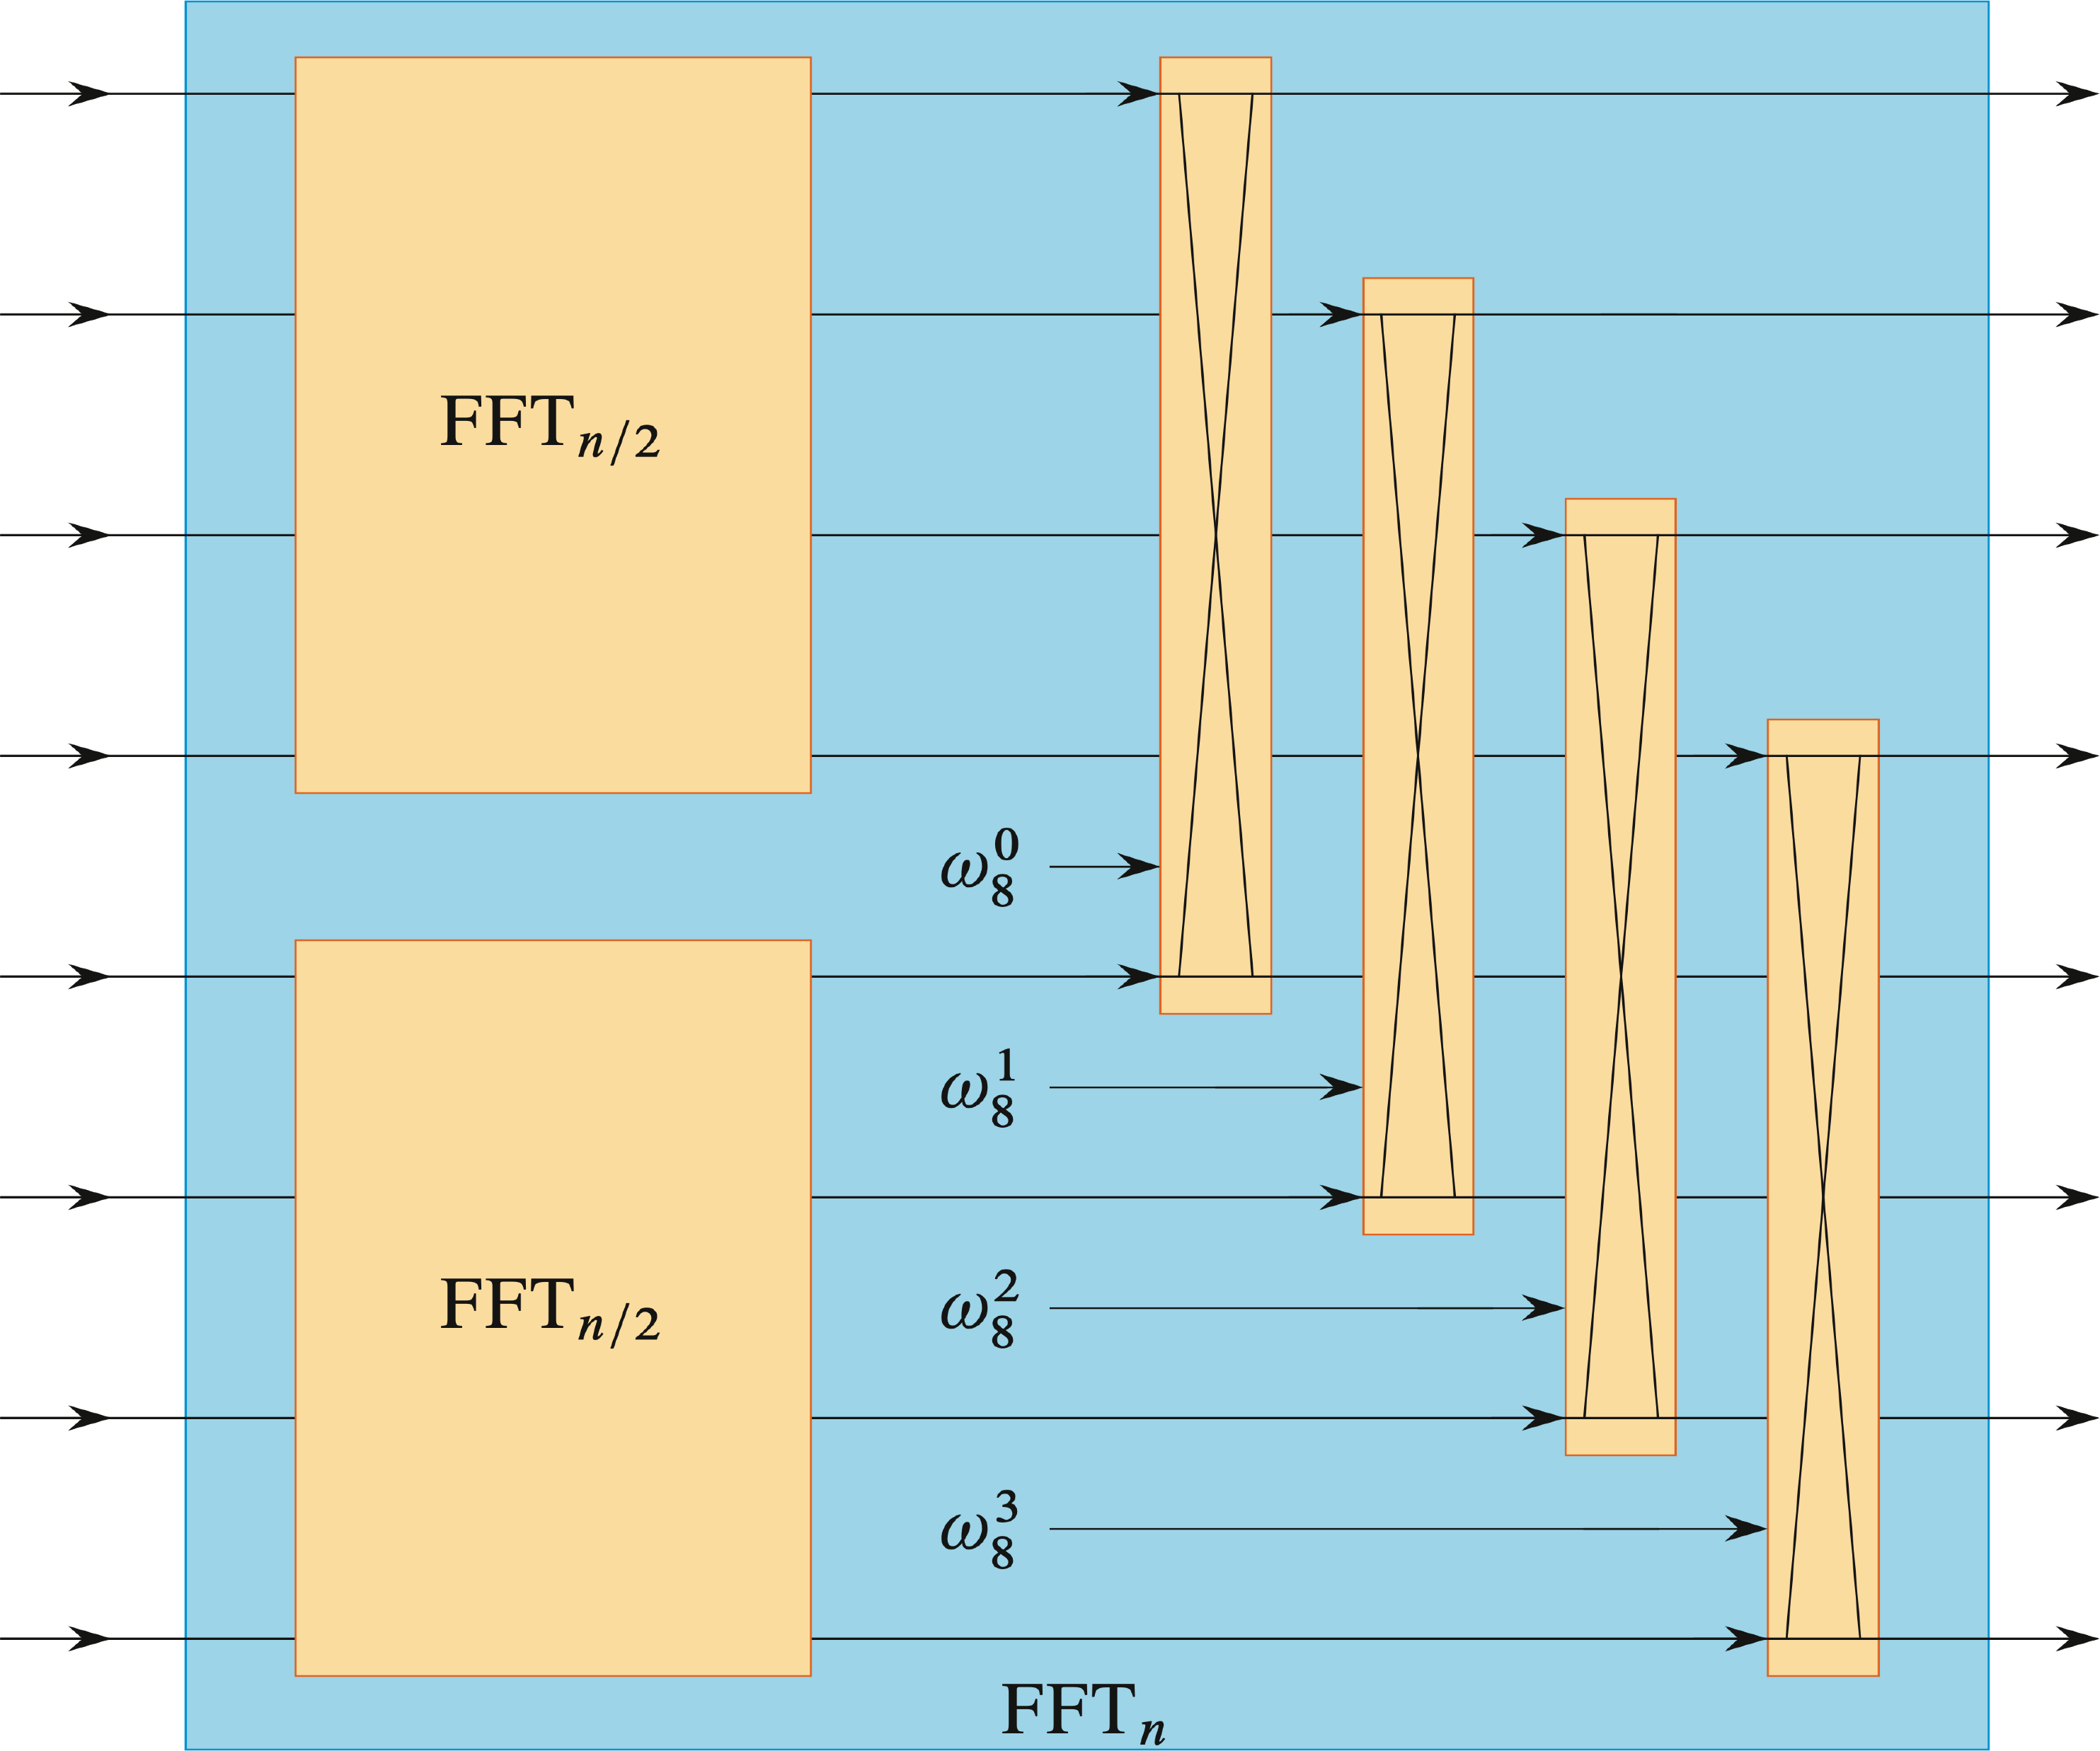
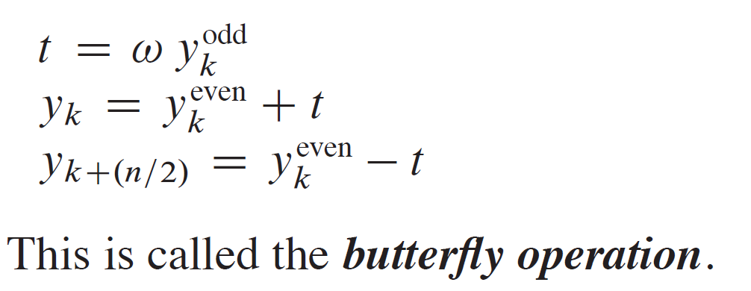
PSEUDOCODE
Optimize the loop by pulling out common subexpressions:

Slide 30
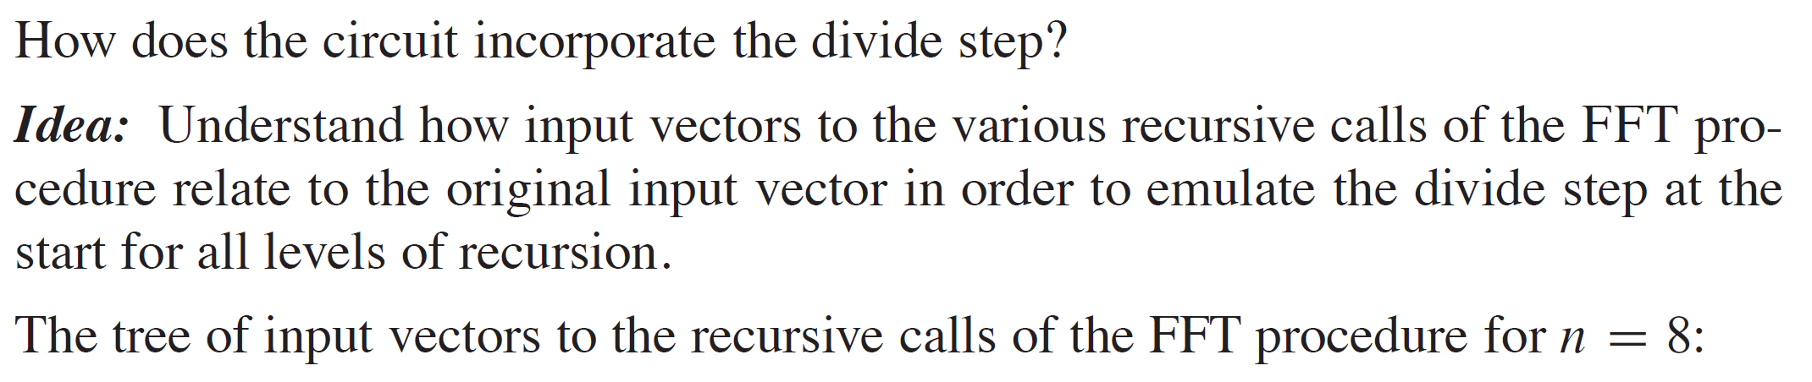
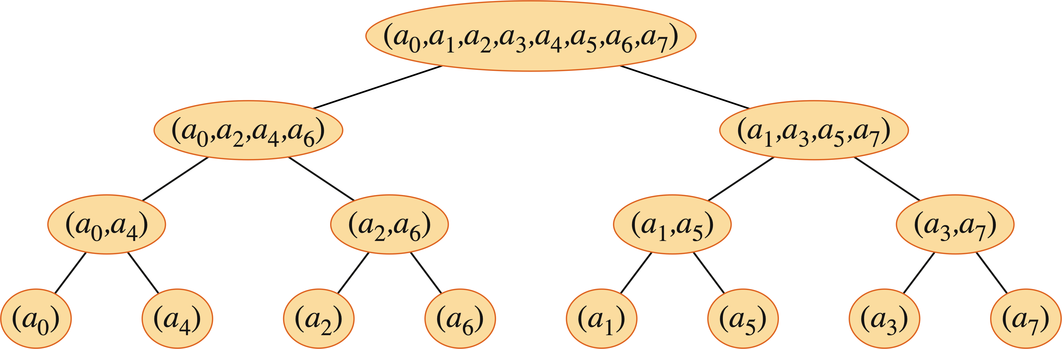
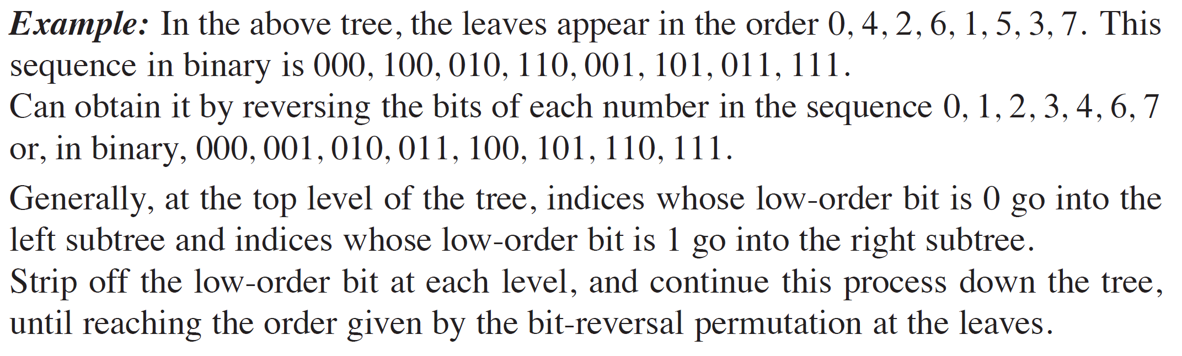
PERMUTING THE INPUTS

Slide 31
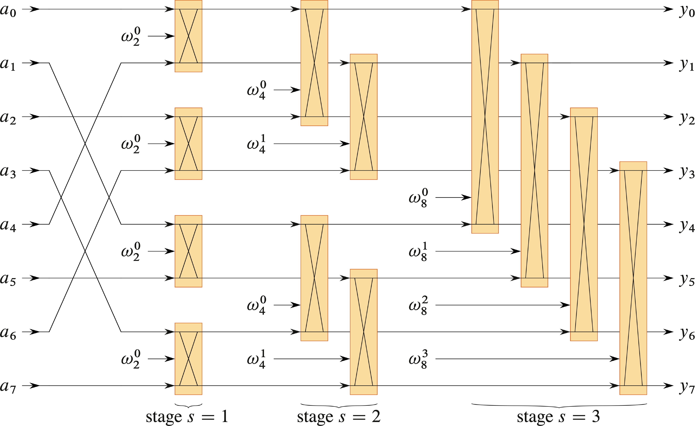
THE FULL FFT CIRCUIT
Notes:
Instructor to explain verbally.

